Slide 1

Laser Target-Shooting
Group 6
Cameron Vo – Optical Engineering
Eltholad Orelien – Electrical Engineering
David Johnson – Electrical Engineering
Quang Pham – Computer Engineering
Notes:
David Johnson
Hello. We are Group 6, and our project is the “Laser Target-Shooting.” Our members are Cameron Vo, Eltholad Orelien, David Johnson, and Quang Pham.

Slide 2
Motivation
Live Firearms
Expensive, inconvenient, dangerous, and harmful for the environment
Airsoft
Quite expensive and still harm the environment
Lack some features of real guns such as recoil
Lasers
Decreased danger, environmental impact, and ammunition cost
Portability and accessibility increased
Notes:
David Johnson
When planning this project, we were mainly motivated by how to simulate a shooting range experience to train your shooting skills and gun safety while making them more safe and consumer friendly.
Compared to using live firearms and airsoft, we believe that lasers can provide a safe and realistic alternative for training

Slide 3
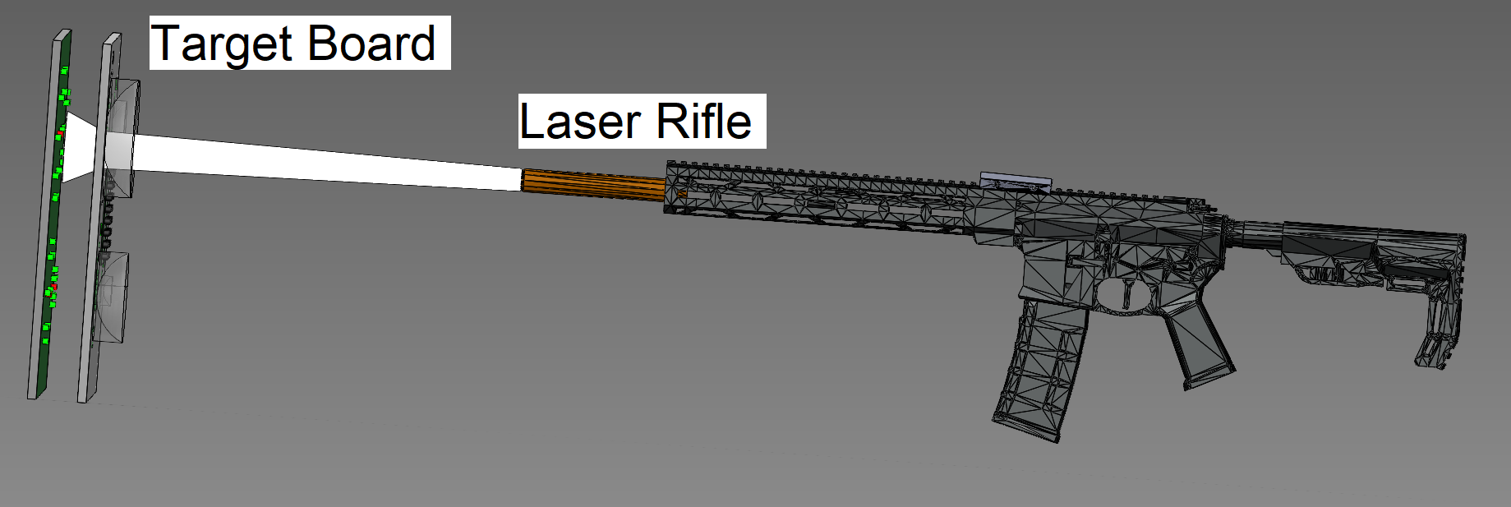
Goals
Create a laser-target shooting system that gives immediate feedback to where a shot is made via LEDs
Portable system usable in both broad daylight and nighttime
Implement features to simulate real firearms (recoil, gunfire, etc)
Develop smartphone app to control system for customizability
Notes:
David Johnson
Our main goals of this project are to create a working laser-target shooting system that gives visible feedback to your shot placement using LEDs. It will need to be portable and usable in extreme lighting conditions such as broad daylight and midnight. It will include many features that will be customizable and controlled using our smartphone app.

Slide 4
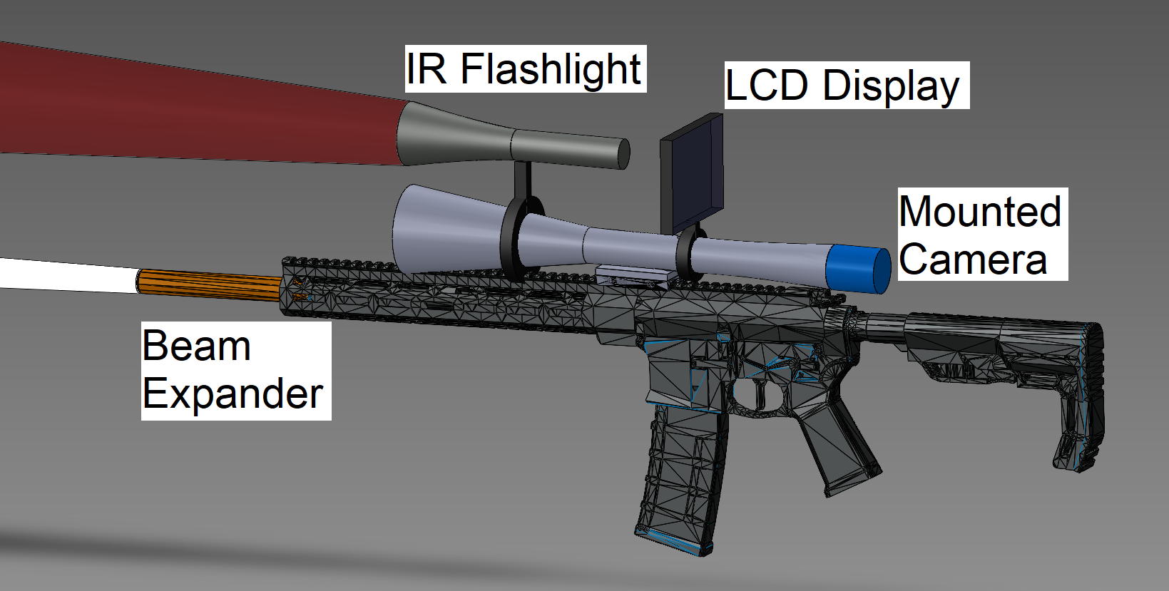
Objectives - Rifle
Frequency modulated IR laser diode
Spot size and divergence angle controlled by beam expander
Battery-powered
Rifle Scope
Mountable Night Vision System
IR Flashlight, CMOS Camera, LCD Display
Pairs to smartphone app via Bluetooth
Customization of features i.e. gunfire sounds
Software-based magazine and ammo system
Notes:
David Johnson
Our main objectives are split into the rifle and target board. There is a IR laser diode that is frequency modulated with a beam expander installed to control spot size and divergence angle. For the rifle, we used batteries to power the whole system. We also created a custom rifle scope that came with a removable night vision system for aiming and use at night. The rifle pairs to smartphones using Bluetooth to control features and keep track of the rifle’s status.

Slide 5
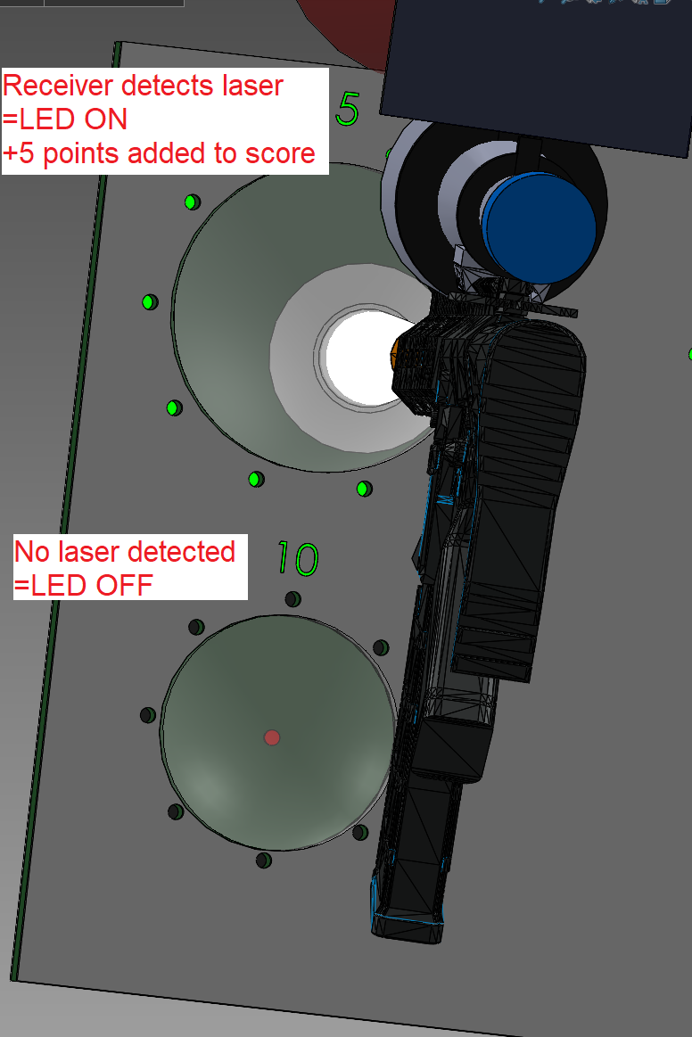
Objectives - Target Board
IR Receivers
Only detects modulated light at the IR laser frequency
LEDs
Lights up when the laser is detected by a receiver
Built-in Concave Lenses
Reduce optical and thermal noise and expand the beam further
Pairs to smartphone app with Bluetooth
Keeps track of score and used for setting up systems
Notes:
David Johnson
For the target board, we used IR receivers, which are basically photodiodes that only detect light modulated at a specific frequency within its spectral range. LEDs light up when the target is hit by the laser and provide visible feedback. There is also a built-in concave lens apart of the target board, to reduce optical noise and expand the beam further to reduce the amount of IR receivers needed. The target board pairs to the smartphone app via bluetooth and keeps track of the user’s score

Slide 6
Requirement ID | Requirement/Specification
1.0 | The system will not exceed 10 lbs with all internal components. | 5 - 10 pounds
1.1 | The system will be pairable with a phone through Bluetooth and be recognized by the mobile app. | Bluetooth 5.0 or Bluetooth Low Energy
1.2 | The system will be powered by batteries that can be recharged with a compatible plug. | 9V Lithium Battery(s)
1.3 | The system needs to perform at the shortest time interval between the pulling of the trigger and the visual response of the target. | < 1 second
1.4 | The laser target shooting system idle power should be low. | Rifle- 1Wh Target- 0.5Wh
1.5 | The system should be in “ready for use” state within a short time after startup. | < 1 minute
1.6 | The system should have the controller stay running at a high uptime. | > 4 hours
1.7 | The system should operate without overheating. | < 50 °C
1.8 | The system will include a mountable rifle scope with high resolving power | > 3.5x magnification <0.15 mrad angular resolution
1.9 | The system will be able to fully function at a long distance between the rifle and target board. | >15m
1.10 | The system will emit a laser beam that has low divergence such that it can be used accurately at long ranges. | <1.5 mm per meter (1.5 mrad)
1.11 | The system will output a laser spot size that is small enough to ensure accurate shot placement on the target board. | <40 mm at 15m target distance
1.12 | The system will emit a laser beam that is considered low-risk for eye safety. | Class 3R (<5 mW)
1.13 | The system will use a 3D printed target board that is large enough to be clearly visible at long ranges while also being portable | > 200mm x 200mm < 10 lbs
Notes:
David Johnson
This slide will detail our Requirements Specifications for our project.
Along with all of our requirements, we have also highlighted 3 system specifications that were shown in our demo. The system should have been able to provide visible feedback to the user in as short of a time period as possible. The system also needed to be able to be fully functioning within the designated start-up time. The system also needed to function at at least 15m away.

Slide 7
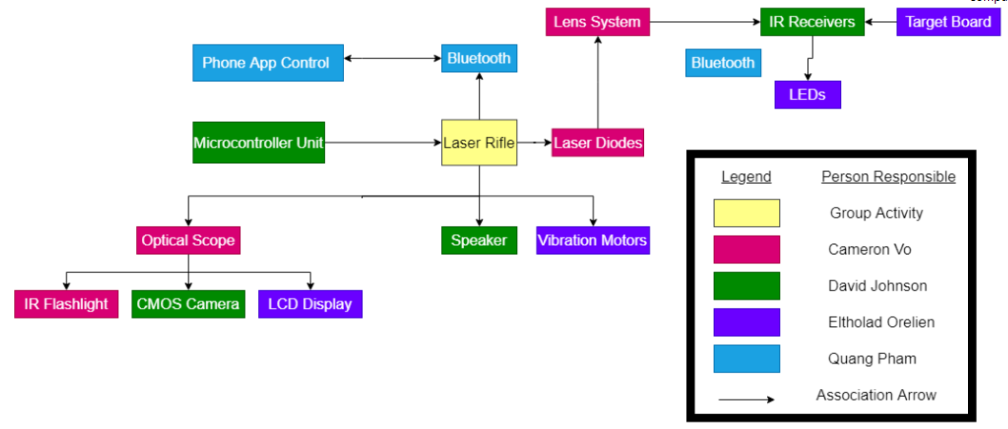
Hardware Block Diagram
Notes:
Quang Pham
This is our hardware block diagram, which gives a basic overview of all hardware aspects of this project and how they interact with each other. It also shows the role of each member in the project.

Slide 8
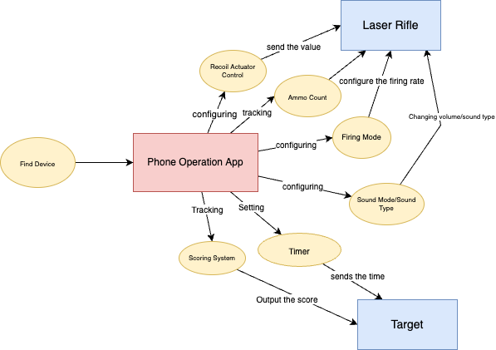
Software Block Diagram
Notes:
Quang Pham
This is our visual illustration of the mobile operational application system that represents a few concepts that our group member have decided for. The mobile app pairs with our Laser Rifle and the Target board app feature that we named as FIND DEVICE which is basically using the Bluetooth technology to connect them.

Slide 9




Software Design Tools: Mobile Application
Tools | Features
Figma | Multiple devices screen size
Arduino IDE | built-in libraries and example codes. Open source.
Visual Studio Code | Built-in support for development applications. Great extensions to customize the edit-build-debug experience.
React Native Framework | Open source, reusability components, similar structures to React JS
Figma
Notes:
Quang Pham
our software design is the mobile application development. Our team design User Interface are using wire frames from Figma. Figma has all features necessary for the app development.
React Native is an open source framework for building Android and iOS applications using React and the app platform’s native capabilities.
We then choose VS Code as our primary code editor. And then we chose Arduino IDE to flashing programming code onto our designed Microcontroller Unit.

Slide 10
Software Design Approach and Implementation
Technologies | Supported Operating Systems | Features | Coding Language | Cost
Flutter | Android & iOS | Open source, multi-platform, rich widgets | Dart | Free
React Native | Android & iOS | Open Source, and multi-platform. Reusable components | Javascript, Typescript | Free
XCode | iOS | Easy to learn Syntax, native on Apple platform, and Open source. | Swift | Free
Android Studio | Android | Open source, native on Android platform, and well optimized for Android apps. | Java, Kotlin | Free
Notes:
Quang Pham
This is a table about our software design approach for mobile application. We decided to use React Native because it’s compatibility with multiple devices for Both Android & iOS. Our team member is also familiar with the React js code and we like that React Native has a similar structure to the React JS.

Slide 11
Rifle Design Approach and Implementation
Rifle serves as the main device for users
User interface and system control is done through mobile app
Additional Subsystems:
2 main buttons (reload & trigger)
Laser Diode
Haptic feedback
Notes:
Eltholad Orelien
The rifle in our system acts as the primary device for the user – users configure settings through a mobile app that will provide things like game information and data tracking. As such, ergonomics, user experience, and reliability are important while designing this device.
The additional subsystems that are required for this device are the additional buttons (ie reload switch trigger), the laser diode and haptic feedback. These components work together to create a familiar rifle experience

Slide 12
Target Design Approach and Implementation
Similar hardware approach to reduce complexity
MCU, audio and power
Targets are slightly more passive elements
Mostly responds to game coordination commands from Controller
Additional Subsystems
IR receiver / Laser Detection
LED target indication
Notes:
Eltholad Orelien
It was our plan to maximize similarities in the hardware design of both rifle and target systems to reduce complexity: By using the same audio system, microcontroller and power subsystem
As a target normally would, the target board in the system acted in a more passive role – It simply listens for either messages from the users phone or the excitation of a laser, then act upon that. Because of this, it isnt as computationally active and are somewhat simpler in their design.
The target board does have some additional subsystems, however – the IR receivers for laser detection, and a LED array to serve as a visual indicator during gameplay.

Slide 13
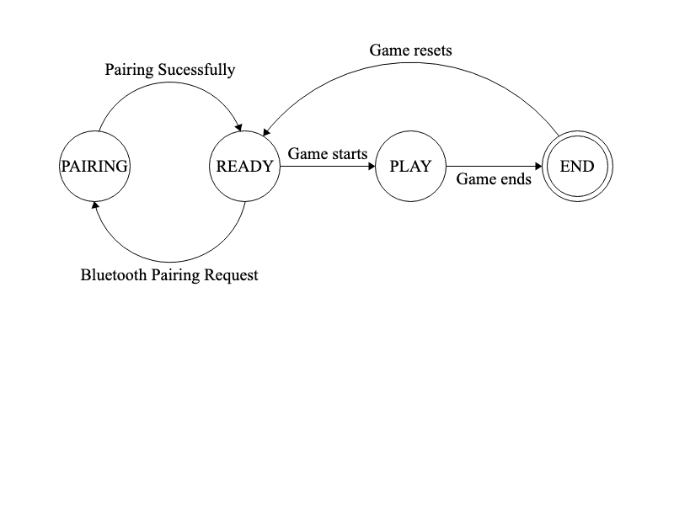
System Features Design
The system will be event-based.
Using a Finite State Machine for illustration:
Laser Rifle and Target Board MCU State Machine Diagram
Notes:
Quang Pham
We choose the Finite State Machine illustration for our system. Here there are four states: PAIRING, READY, PLAY and END denoted by circles. Each state takes some type of input representing a transition arrow, and then outputs the result from one state to another followed by another transition arrow.

Slide 14

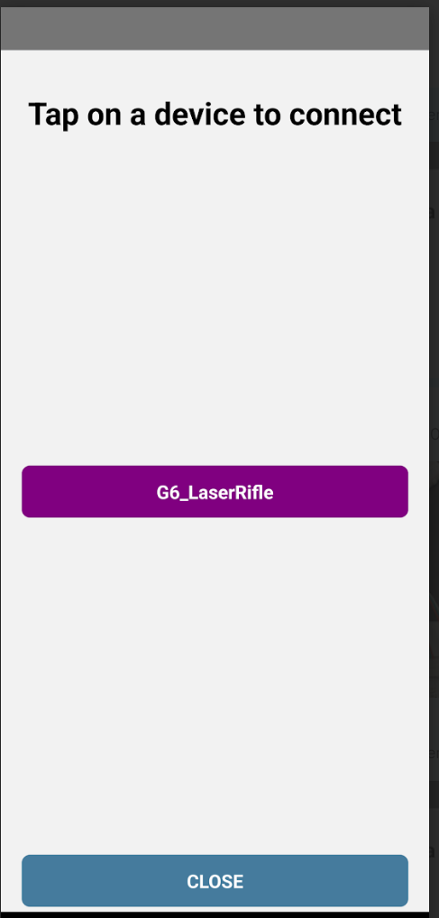
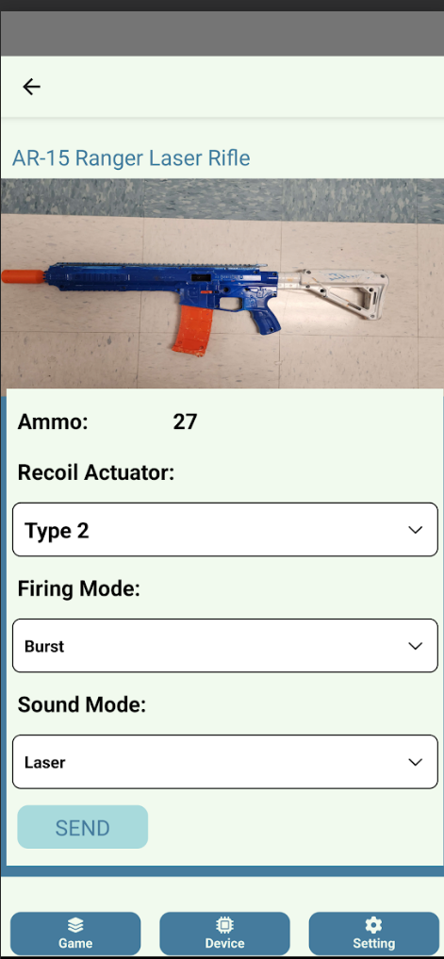
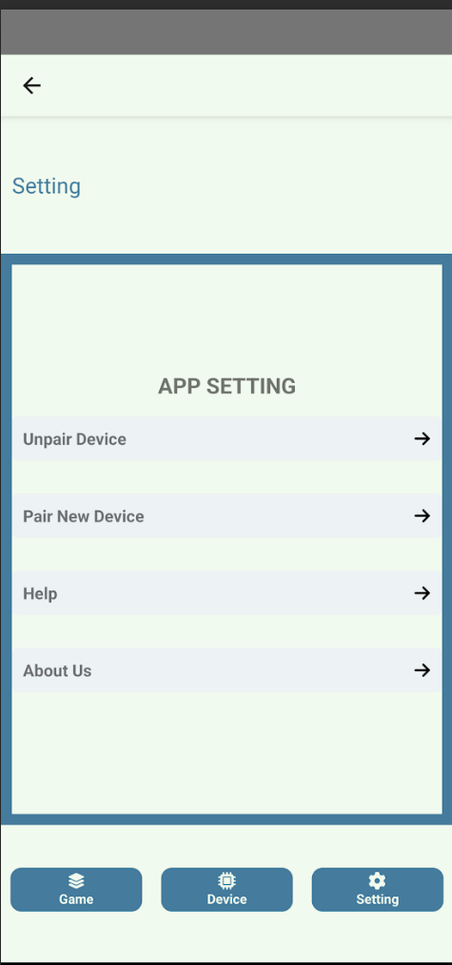
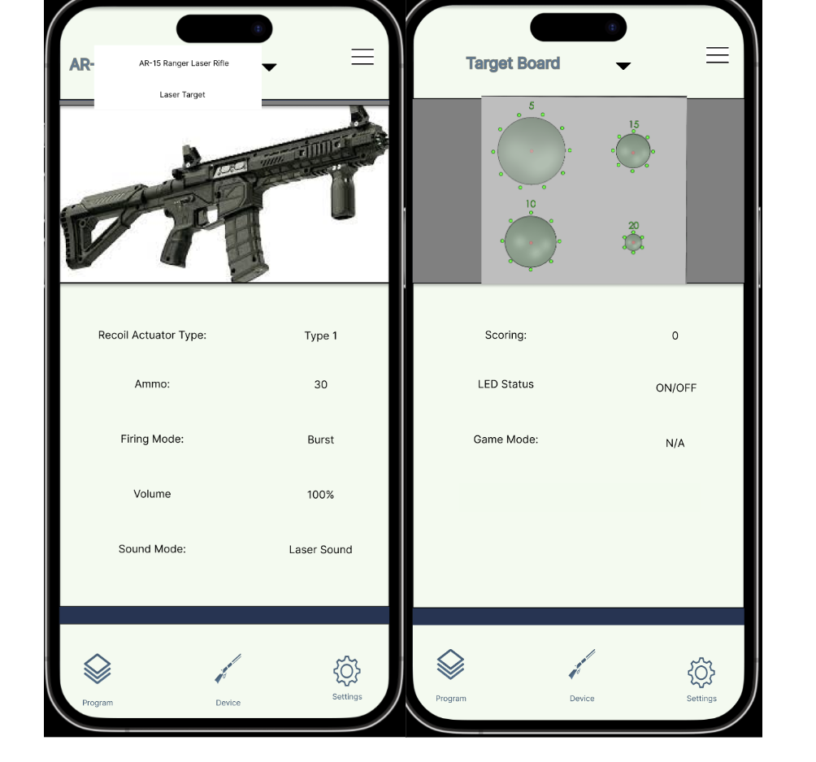
Mobile Application User Interface Design
Notes:
Quang Pham
Here is our mobile application user interface. The app will begin its first time setup with FIND DEVICES page as shown on the left. Then once we have connected a device through Bluetooth, we can see the device dashboard with all of its current configuration..
User can modify the Rifle or the Target setting by changing values of each config, and press the SEND button to save the setting. The app communicates with the device and transfers the data to the Rifle or the Target board through the Bluetooth technology.

Slide 15

Bluetooth Connectivity
Bluetooth 4.0 / Bluetooth LE
Less power consumption
Single device
Maximum range 200 ft and 25 mbit/s speed
Notes:
We choose the Bluetooth technology as our main data communication between the device and the mobile phone. So We decided on the version 4.0 LE because that is what our chosen microcontroller is compatible with. It has less power consumption and has good range that meets our specifications.

Slide 16
Microcontroller Requirements
Bluetooth functionality
≥ 20 GPIO Pin connections
Clock Speed ≥ 50 MHz
Low power / power saving mode
Notes:
David Johnson
Here we have our microcontroller requirements and specifications that we found necessary when searching for a microcontroller for our system. One of the main things we were looking for in a microcontroller was bluetooth/wifi functionality without the need of an external module. we used bluetooth to connect our rifle and target to the phone application.
For our microcontroller we also wanted to insure we had plenty of pin connections for our current hardware and any future hardware we may add later on.
A high clock speed is important to us so that it can perform operations quickly at a low price.
A low power mode is important so the laser gun is ready to be turned on at the flip of a switch. Low power mode is also useful for bluetooth so that the device is always discoverable by the phone application.

Slide 17
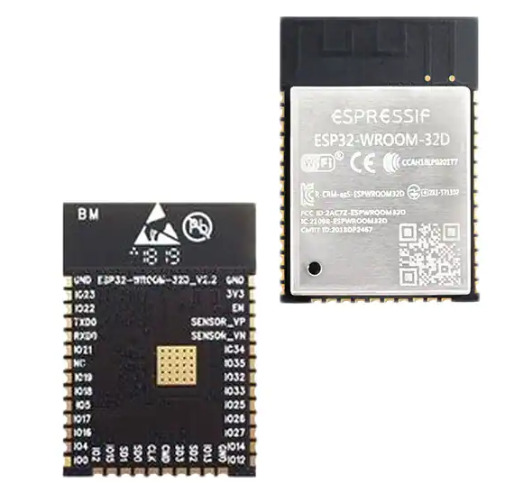
Microcontroller Selection
Company | Arduino | Texas Instruments | Espressif Systems
Microprocessor | ATmega2560 | MSP-EXP430G2 | ESP32-WROOM-32-N4
Operating Voltage (V) | 5V | 1.8V – 3.6V | 2.7V – 3.6V
Current Draw (mA) | 40 | 1 | 500
Bluetooth (Stock) | No | No | Yes
Wi-Fi (Stock) | No | No | Yes
Clock Speed | 16 MHz | 16 MHz | 80 - 240 MHz
Availability | Available/Own | Available/Own | Available/Own
Notes:
David Johnson
This section shows how we selected and decided on which microcontroller to use for our project. We researched and looked at many microcontrollers before finding just three that we were interested in. We were already familiar with the Arduino and Texas Instruments boards from prior projects and course work which made them viable options. However, as you can see the ATmega and MSP430 don’t have the option for Wi-Fi or bluetooth functionality without adding an additional module. We chose the ESP32-WROOM for it’s bluetooth functionality, compact design, and processing power. We will use the ESP32 controller on both the laser gun and the target system.

Slide 18
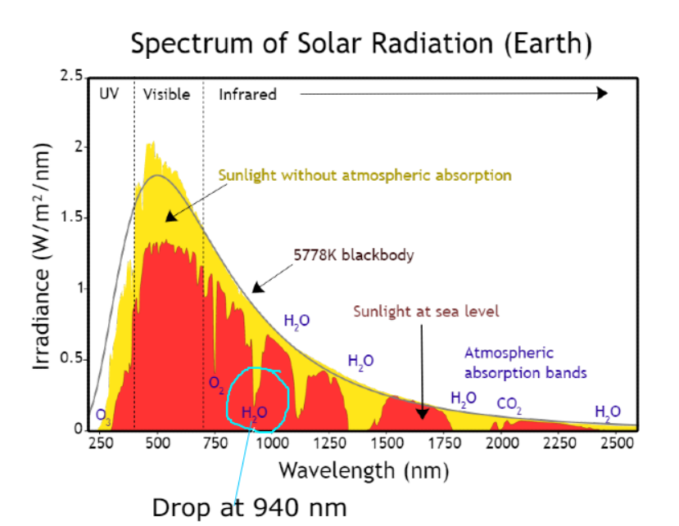
Wavelength Selection
In deciding wavelength, we considered the:
Least amount of optical noise
Compatibility with commercial photodetectors
Ability to find low-power laser diodes
Cost of related components
We chose 940 nm as the wavelength
Notes:
A major part of our project is determining the wavelength we wanted to work with. Since we wanted to work outdoors, a wavelength where there is the least amount of optical noise possible is ideal. We also needed to be able to find photodetectors that are made to detect the wavelength. We also needed a low-power laser diode that emits at the desired wavelength. Finally, all of these components needed to be well-priced. optical noise is much less common at 940nm and these components can be easily found on the market for quite cheap, so we picked 940nm as our laser wavelength

Slide 19
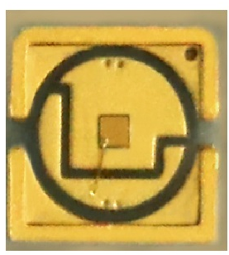
Laser Diode Selection
There are not many low-power 940 nm laser diodes available
RPMC Laser VD-0940C-008M-1C-410 ($13 each)
940nm 8mW VCSEL diode
3.5mm x 3.5mm x 3.5mm in size
Built-in Collimating lens (<10 mrad divergence angle)
Since laser power must be <5mW, we used:
Uncoated lenses for beam expander
Apertures
Reduces spot size for more accuracy while cutting optical power
Notes:
For this wavelength, there are not many low power laser diodes available, so there is not much room for comparison. We got the RPMC laser 8mW VCSEL diode which comes with a built-in collimating lens in a very small package. Since our requirements are that power must be below 5mW, we dropped power using blocking apertures and using uncoated lenses in the beam expander to decrease transmitted power

Slide 20
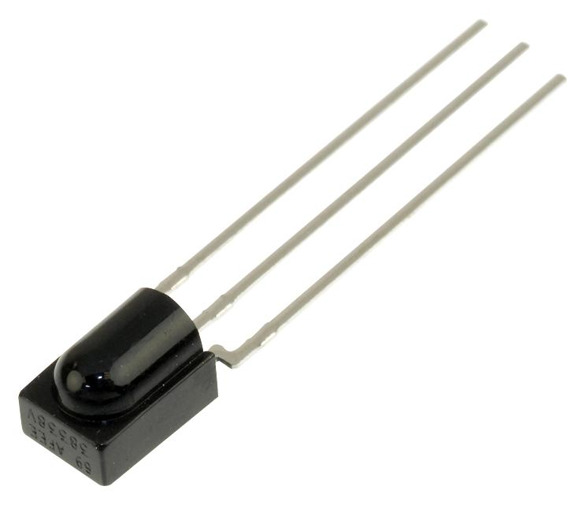
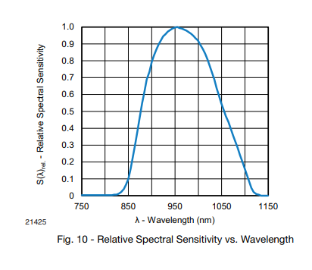
Photodetector Selection
We chose to use IR receivers, which are photodiodes that:
Only detect modulated light
Effective countermeasure against optical noise
Output a digital voltage signal upon receiving signal
VS1838B IR receivers ($0.05 each)
Reacts to 940nm light modulated at 38 kHz frequency
Outputs 0.3V signal in response
Low supply current (500 uA idle)
Notes:
We chose to use IR receivers, which are photodiodes that only detect modulated light. This makes them useful for suppressing optical noise. Instead of outputting a photocurrent, the receivers output a digital voltage upon detecting the modulated light. We used receivers that are made to detect to light modulated at 38kHz, outputting a 0.3V digital signal in response.

Slide 21
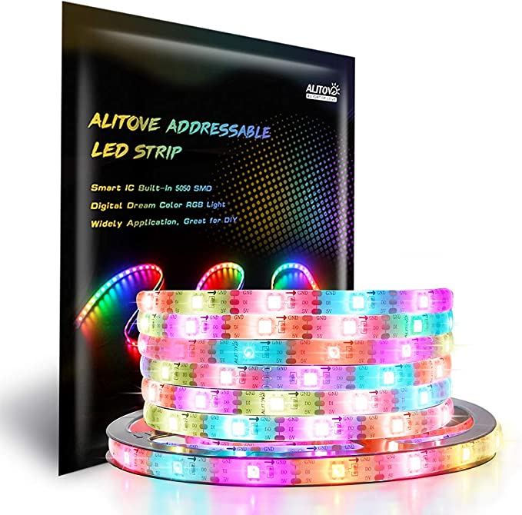
Target Board LED Selection
We chose to use LED strips placed on the target board
ALITOVE WS2812B LED Strip ($24)
5V
Programmable
Notes:
We had a couple of different ideas for the LED designs, which include singular LEDs, or LED strips, and a matrix. The strips and matrix would be more convenient since we would just buy them, but the preinstalled LEDs would have high viewing angles, meaning that much of the light will be spread out over a large region. At a long distance like 15m, most of the light should be directed towards the user to avoid wasting energy, which would be avoided if we used lower viewing angle LEDs.
In our final design, we used an LED strip since they are in series with one another and give a nicer overall look to our target boards while being easy to hookup. The LED strips we have looked at are 5V and our microcontroller outputs 3V, so we needed a level shifter to ensure the LEDs run at the proper voltage.

Slide 22
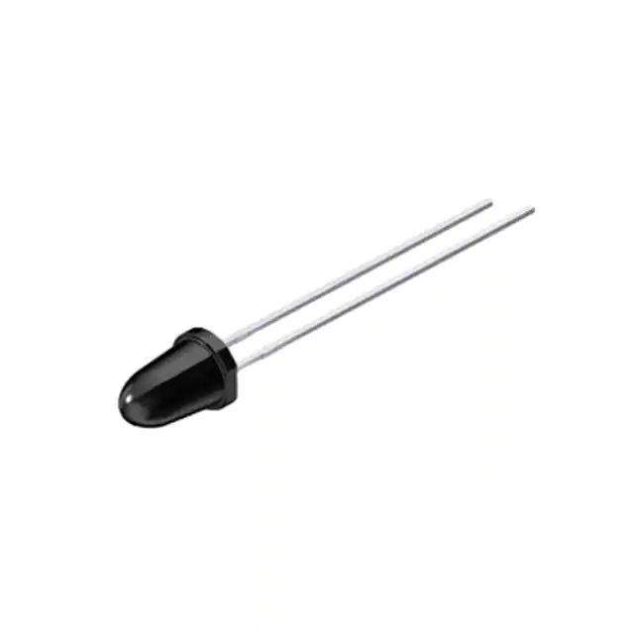
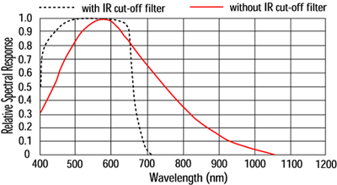
IR Flashlight LED Selection
Only needed to worry about the optical power and wavelength
Flashlight lens system will change the angle of the light
Wavelength must be detectable by CMOS camera
Osram Opto SFH 4555 ($0.49)
860 nm Through Hole LED
550mW/sr @ 100mA
CMOS Spectral Sensitivity
Notes:
The IR Flashlight LEDs was decided based on the optical power and wavelength. Unlike the target board, viewing angle isnt as important since the flashlight lens system changes the angle of the light. So we needed a strong LED that the CMOS camera would be able to detect. We got the Osram Opto LEDs which are very powerful

Slide 23
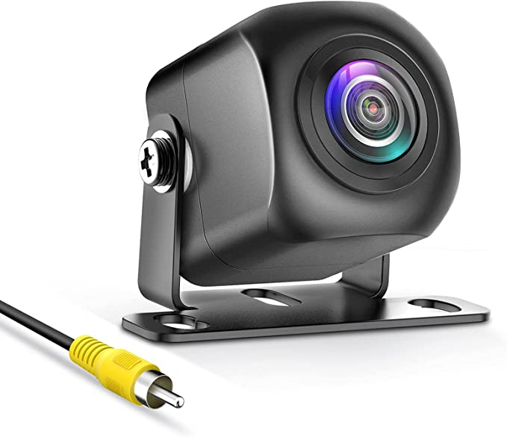
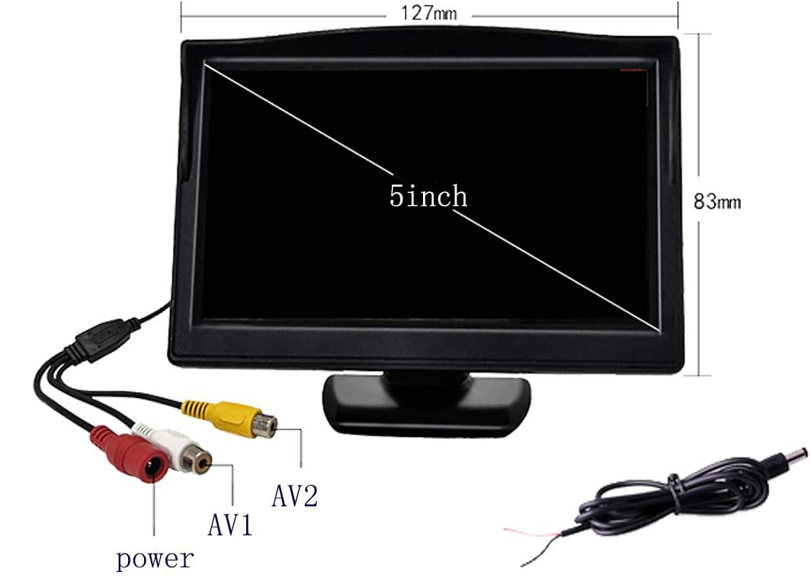
CMOS Camera and LCD Display
We used analog video transmission
Digital requires extra computing device (Raspberry Pi) just to send video
Needed best image quality, no IR filter, and good light gathering
PixelMan PMD2A Camera ($40)
F/1.4 lens system and 1/2.7 inch color CMOS designed for low-light
1080p with 170 degree FOV
Padarsey 5 inch TFT LCD Color Monitor ($25)
Notes:
We chose to use analog video transmission since digital would require us to get a separate computer like a Raspberry Pi just to send video to the LCD display. For the camera, we looked for the best image quality, ability to see Infrared, and good light gathering capabilities. We got the Pixelman Camera which outputs 1080p video and is designed for light gathering. For the LCD display, we narrowed down our results based mainly on the size since it would need to be portable while being large enough to look at comfortably

Slide 24
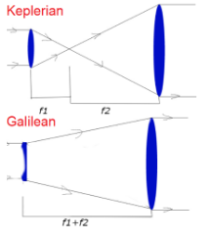
Beam Expander
Increases the spot size of the laser
Decreases the divergence angle of the collimated beam
The smaller the angle, the longer the range the rifle can be used
Galilean beam expander
Less space than using two positive lenses (Keplerian)
-25 EFL biconcave and 200 EFL biconvex
8x Spot size increase and 87.5% decrease in divergence angle
Notes:
The beam expander works to proportionally increase the spotsize of the laser while decreasing the divergence angle of the laser beam. Decreasing the divergence angle means the rifle can be used at longer ranges. Since the amount of space we use is important in our project, we used the more compact galilean design with a planoconcave and biconvex lens.

Slide 25
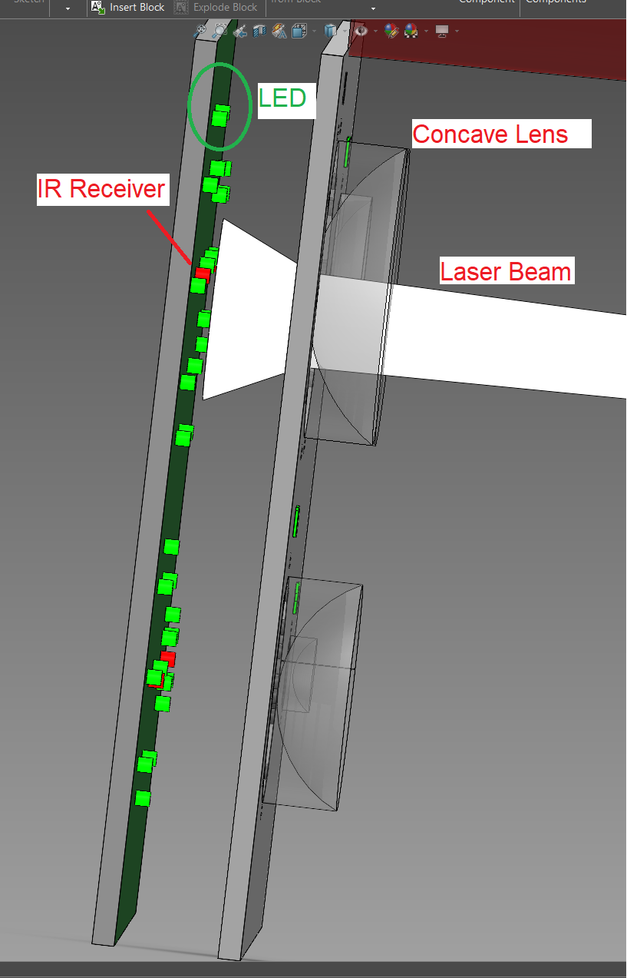
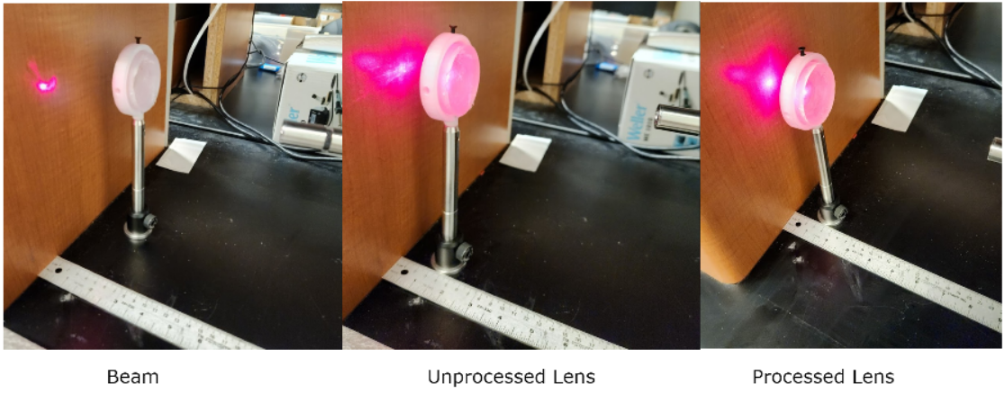
Target Board Lens System
3D Printed PETG Plano-concave lenses
Expands all incoming light through refraction and scattering
Significantly reduces optical noise
Laser beam expands, reducing amount of IR receivers needed in a target area
Concept
Testing
Notes:
The target board lens system uses 3d printed PETG plano concave lenses. These lenses were processed using polishing and sanding equipment. Our tests show that they can have a 50% light transmission after processing. They work by expanding all incoming light through bending and scattering since they are not perfectly transparent. This will reduce optical noise further and expand the laser beam such that we will need less ir receivers in the system.

Slide 26
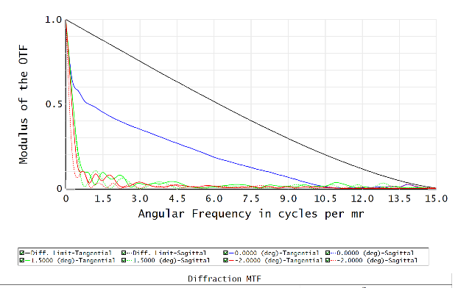
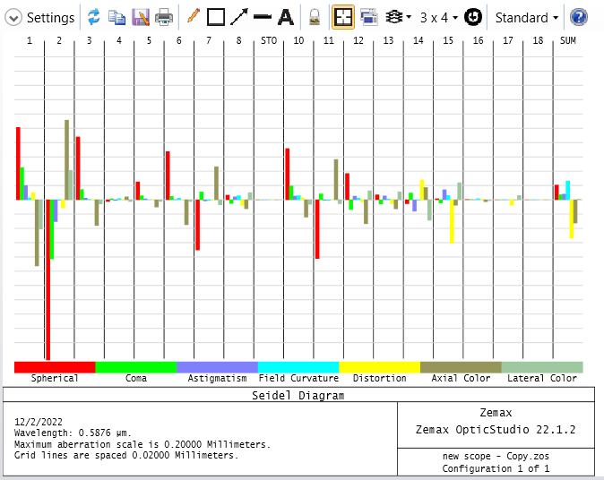
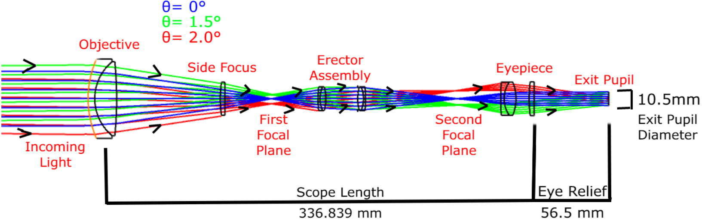
Rifle Scope
6 lenses total, 4 achromatic doublets
Collimated and aberration corrected with 4x magnification
Zemax angular resolution is 0.125 mrad
Experimentally tested to be 0.135 mrad
Light Transmission measured at ~80%
MTF
Aberration Chart
Zemax Simulation
Notes:
The rifle scope has 6 total lenses with 4 achromatic doublets. The system has a 4x zoom with a theoretical max angular resolution of 0.125 mrad, although our experiments have shown it is 0.135 mrad. At 4x zoom, the scope has exit pupil parameters that are similar to that of rifle scopes sold commercially The light transmission through the system is around 80%.

Slide 27
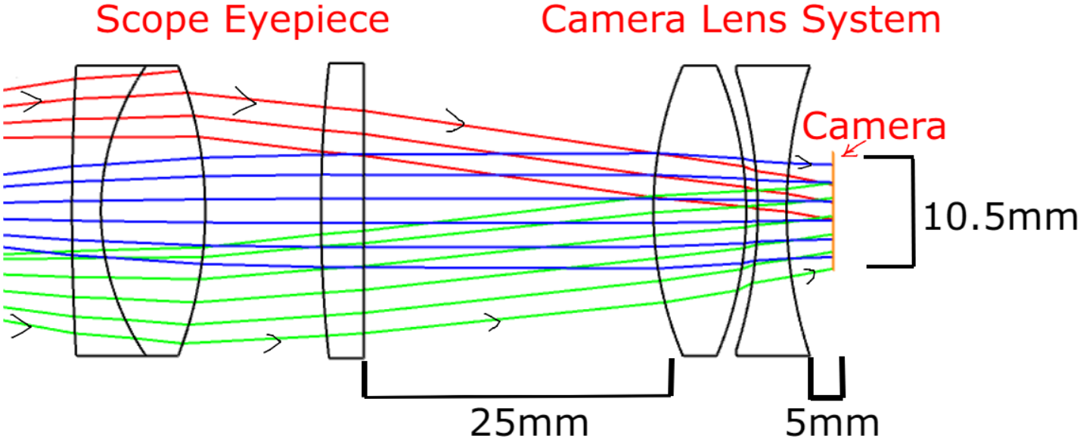
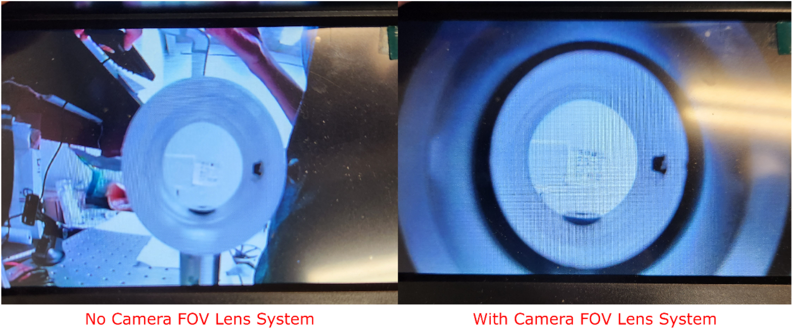
Camera FOV Lens System
Default Camera FOV is 170 degrees
Much of the image is wasted showing interior of scope rather than image
25mm EFL combined with -25mm EFL lens
Magnifies image while decreasing FOV to 110 degrees
Not great, but decreasing FOV too much degrades image quality
Zemax Simulation
Testing
Notes:
The camera FOV lens system works to increase the amount of usable image outputted by the camera. Since the FOV of the camera is 170 degrees, much of the image is wasted as shown in our tests. By using a combination of a biconvex and biconcave lens, we magnify the image and decrease FOV to 110 degrees, which admittedly isn’t great, but decreasing FOV any further made the image far too blurry to use

Slide 28
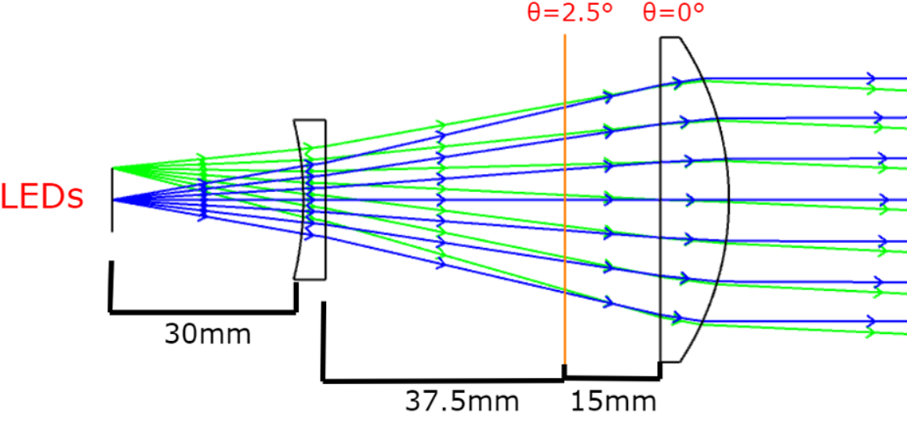
Variable Focus IR Flashlight
Planoconcave combined with planoconvex lens
Compact design
Max axial length is 82.5mm
Planoconvex lens can move 15mm to adjust divergence half-angle (0-2.5 deg)
Zemax Simulation
Notes:
Finally, the last optics design is the variable focus IR flashlight. The IR flashlight will combine a planoconcave lens with a planoconvex lens. The planoconvex lens moves back and forward to precisely adjust from a 2.5 degree half angle to emitting collimated light. The overall design for the flashlight lens is compact and portable and seemed to work well in the tests we have performed

Slide 29
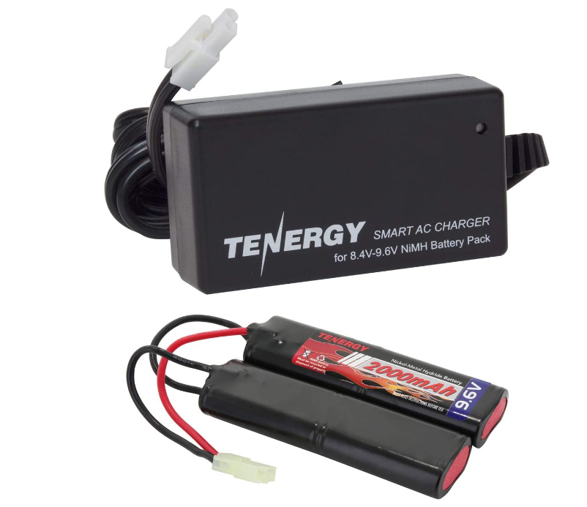
Battery Selection
Rechargeable 9.6VDC - NiMH ($17)
2000 mAh
Common Mini-Tamiya connector type
To be regulated to 5V and 3V for MCU and main components
Advantages:
Availability
Cost
Dimensions are optimal for rifle frame
Battery Protections
Notes:
Eltholad Orelien
Since our project is mobile, spacial limitations and energy density were prioritzied
Due to reliability and performance we Originally searched for Li-ion batteries but to no avail due to pricing and availability
Forced us to look towards Nickel Metal Hydrite supplies despite lower performance so we purchased a 9.6V supply with max current of 2000 mAH from Tenergy
Also Since our project involves a rifle frame it required a battery design that would fit inside said frame while still providing a fair amount of power and this nunchuck design and dimensions were perfect for doing so
Also the provided voltage is high enough that boost converters will not be necessary thus avoiding efficiency penalties
It also provides overcharge, Over voltage and Over current protection

Slide 30
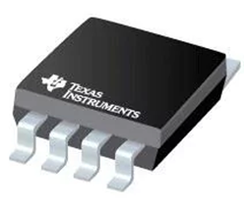
Voltage Regulator Selection
Regulators used UA78M and L7805CDT-TR
Laser rifle and Target board will contain both regulators 5V
Model | Nominal Vout (V) | Output current (mA) | Price
TPS76333 | 1.6 - 5V Variable | 800 | $0.71
UAM78 33CDCY | 3.3V | 500 | $1.36
UA78M05IKVURG3 | 5v | 500 | $0.91
TL2575-05IKTTRG3 | 5V | 1A | $1.32
Notes:
Eltholad Orelien
For our power system selection we looked to have the combination of 3.3V and 5V regulators since both the target and rifle will be utilizing the same battery in their systems. In the beginning we choose both UA78M regulators one 5V and one 3V since both were cheap, had design similarity and provided a decent output current of 500mA. However we found the L7805 regulator would be better suited for active use since its output current can reach up to 1.5A.

Slide 31
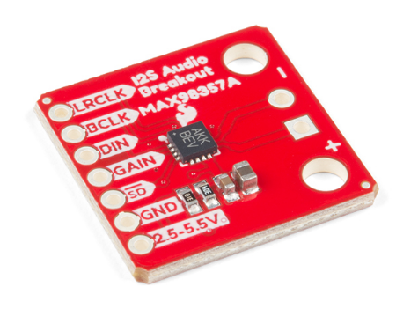
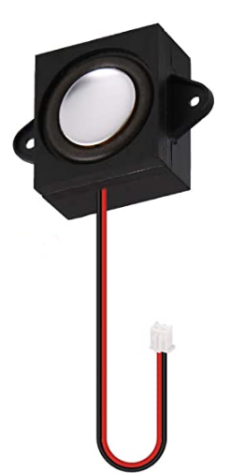
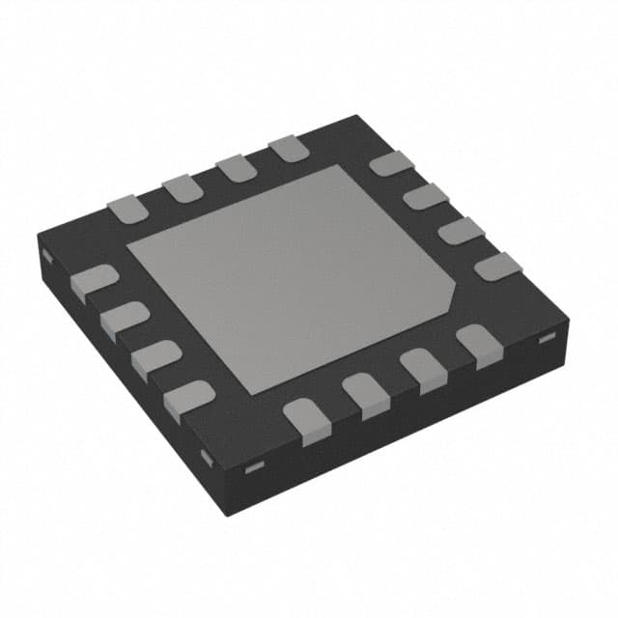
Audio Selection
Audio Amplifier Chip
SparkFun I2S Audio Breakout - MAX98357A
The gain of the amplifier can be configured from as low as +3dB to as high as +15dB
Speakers
Chip required maximum power 3.2 Watt and rated impedance of 4Ω
Found MakerHawk 4Ω 3-Watt Speaker
Notes:
Eltholad Orelien
To keep the audio design simple we found the SparkFun I2S Audio Breakout board that allowed us to test the MAX9835A Audio amplifier chip with ease. The chip itself requires few pin connections and after testing in Senior Design 1 found that when paired with a speaker with the listed power and impedance requirements provides a sufficient audio experience.

Slide 32
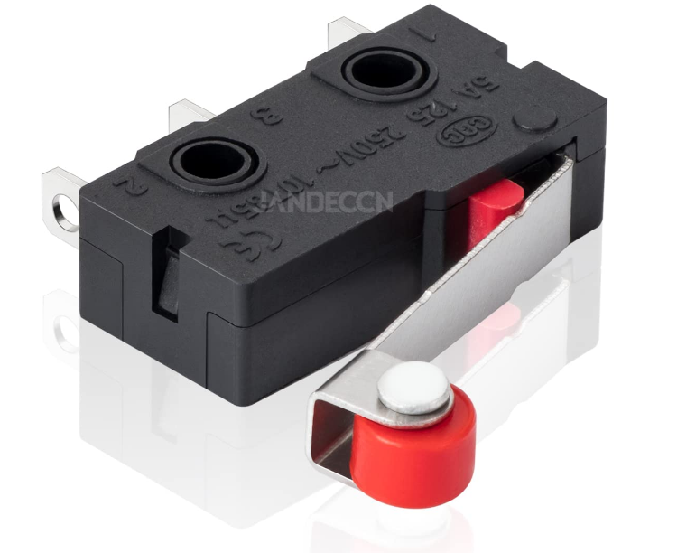
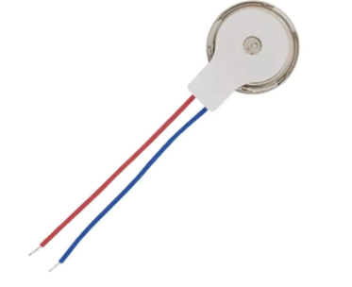
Trigger & Vibration Motor
Vibration Motor
5V Parallax Vibration Motor 28821
Activated by MCU when trigger is pulled
Trigger
JANDECCN Limit Switch SPDT Hinge Roller Lever
Used as the laser activation signal and reload function
Notes:
Eltholad Orelien
In order to successfully simulate a rifle, a trigger is necessary. We have decided to go with the Limit Hinge Roller Switch rated for 5 Amps 250V due to its easy use and high availability. Once pulled it will signal the MCU to drive the laser. The same switch will also be used to implement a physical reload function for the rifle.
To simulate haptic feedback we will be using the 5V Parallax Vibration motor. Once the MCU is signaled to drive the laser it should simultaneously activate the motor.

Slide 33
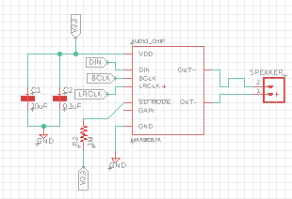
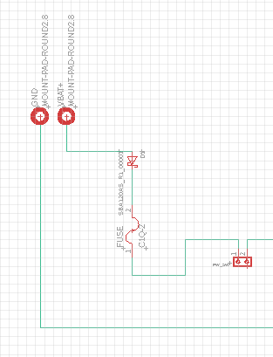
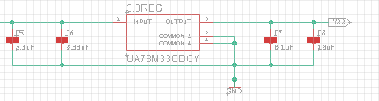
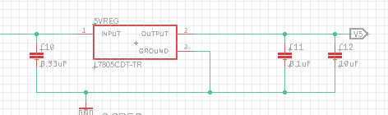
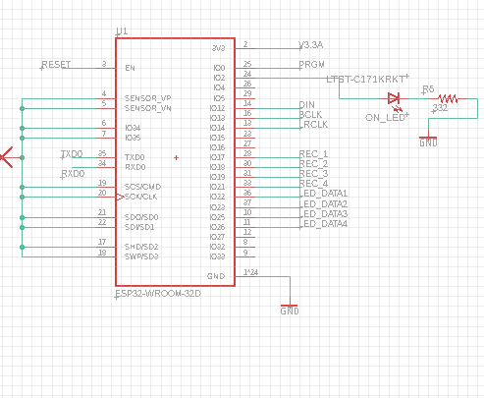
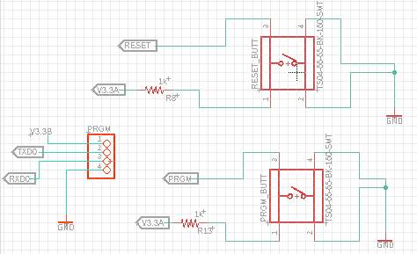
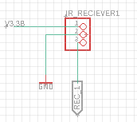
Target Schematics
3.3V Regulator x2
Audio Chip
Battery & On/Off
5V Regulator
Programming Buttons/Pins
ESP32 w/Connections
IR Receivers & Pins
Notes:
Eltholad Orelien
Here is an overview of our schematic for the target. We have ESP32 with its current connections, IR receiver and nodes, buttons for reset and programming, the On & Off switch with battery placement holes, 3.3V and 5V regulators, the audio chip and LED hit detection.

Slide 34
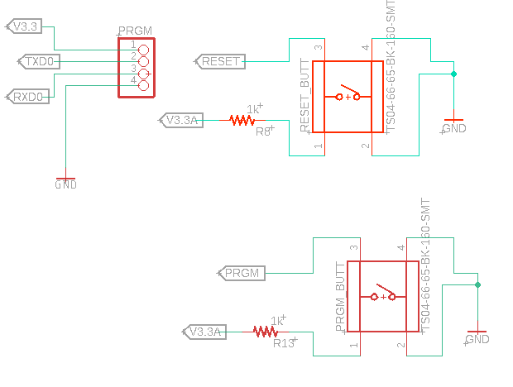
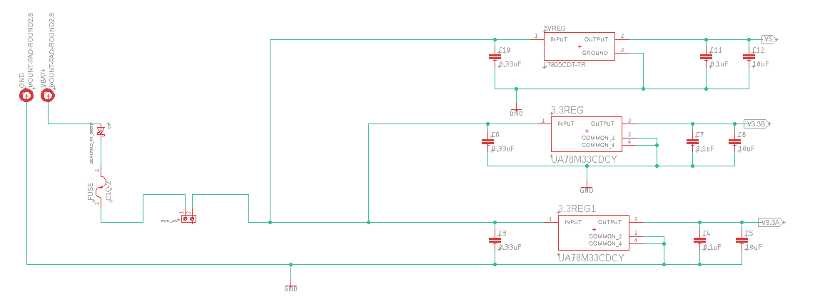
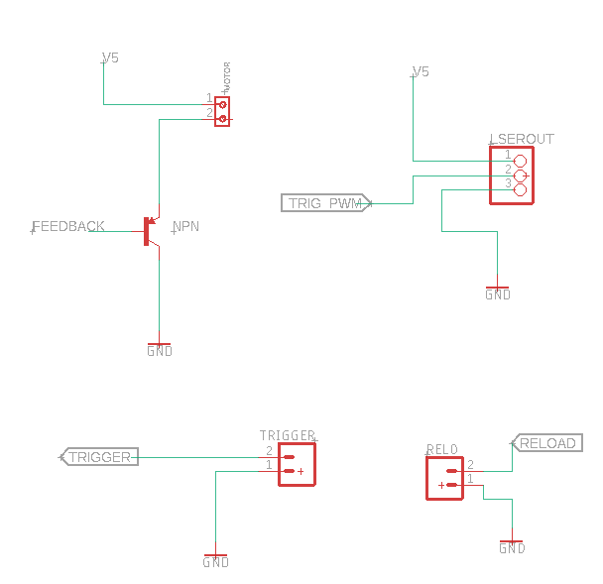
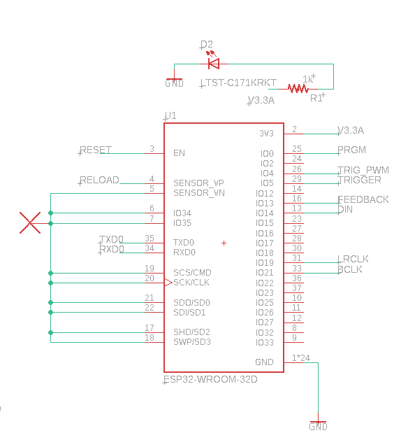
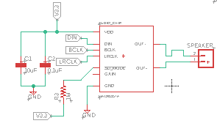
Rifle Schematics
Programming Buttons & Pins
Battery connection/Switch & Regulators
Audio Chip and Speaker
Laser, Trigger, Reload and Vibration Motor
ESP32 & Pin connections
Notes:
Eltholad Orelien
This is an overview of all our schematics for the Rifle. As you can see for simplicity purposes the design is fairly similar to the target. Again We’ve got the ESP32 and all its connections including its programming pins and buttons, we’ve got the audio chip and 3.3V and 5V regulators. However the difference is in the addition to the Laser, Laser trigger, vibrational motor, and reload switch.

Slide 35
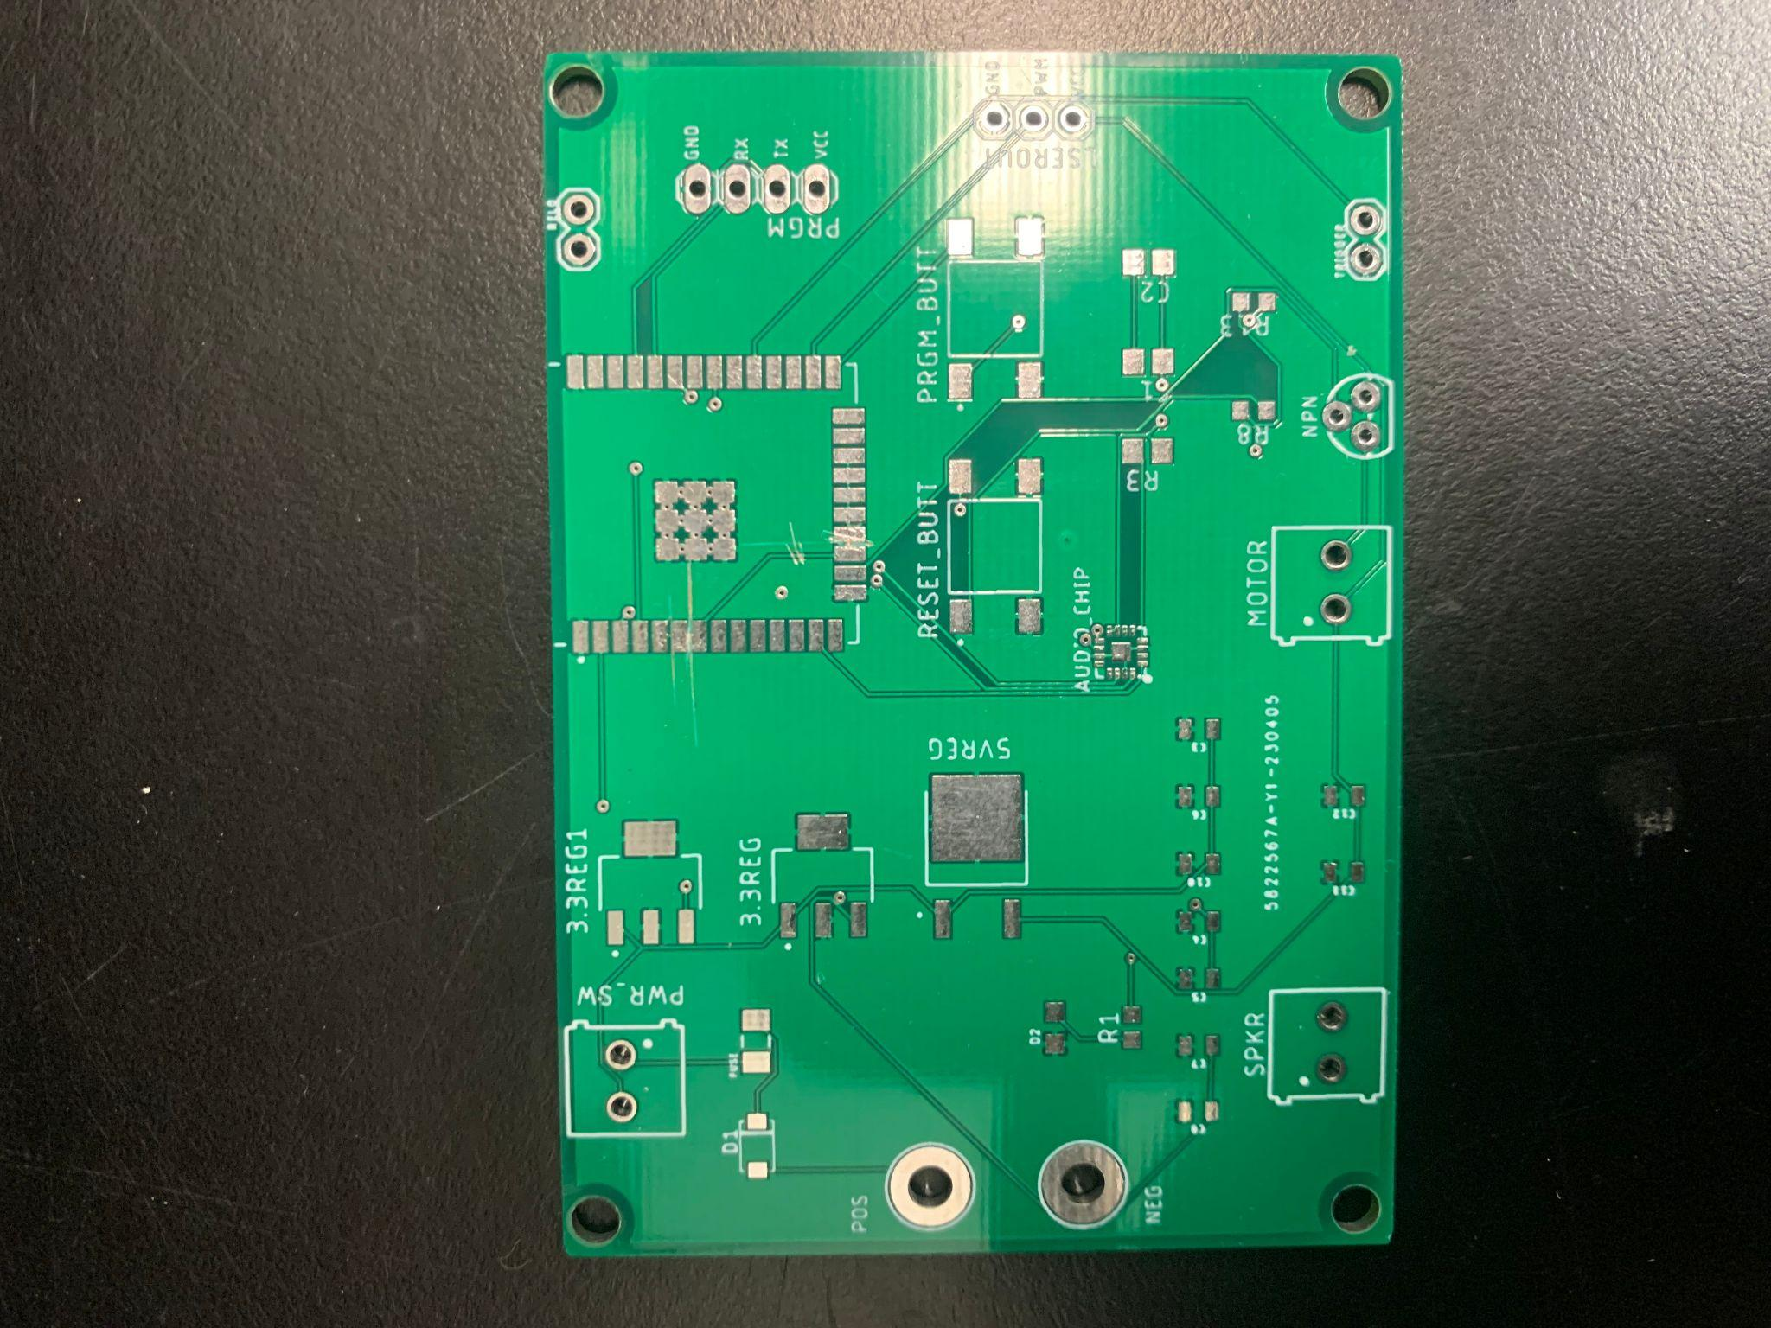
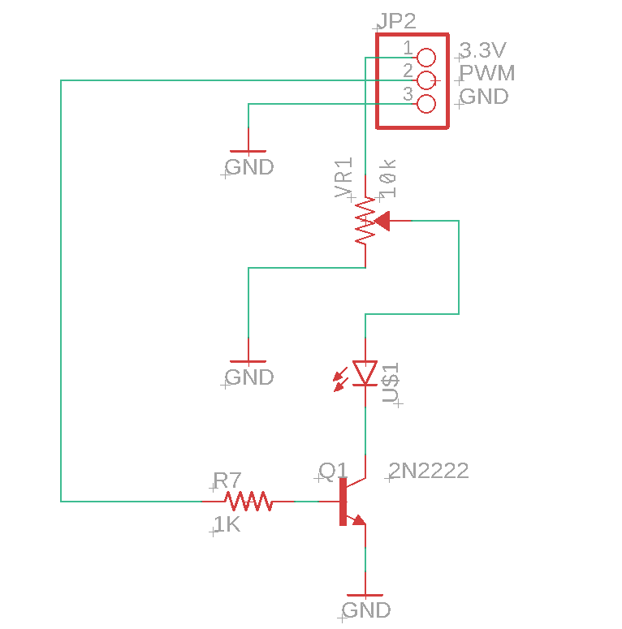


Laser Board Schematic
Rifle board
Target Board
Laser Board
Laser Schematic
Notes:
Since our laser was a surface mount diode it required a separate board to be designed which would include a current limiting resistor and transistor. Also Listed above are also depictions of the printed versions of our boards.

Slide 36

Rifle Enclosure
Notes:
This is a depiction of how each component is placed in the rifle starting at the left with the battery placed in the stock of the rifle to the beam expander placed at the barrel.

Slide 37



Target Board Enclosure
Entirely 3D printed with two separate front and back panels
Lenses are printed separately
Board spray painted using glossy white paint
Increases light reflectivity for use with IR flashlight
Originally had 4 receivers for 4 separate targets on the board
Switched to a single target with variable target area
Target Areas
Original Design
New Design
Notes:
Cameron Vo
We 3D printed the entirety of the target board. It will be 210mm by 210mm in size and will contain a back piece and front piece that will be screwed together. The lenses will be printed separately and fixed into place on the front piece, directly covering the IR receivers on the back piece. The board will also be spray painted using glossy white paint to increase light reflectivity, increasing the effectiveness of the IR flashlight. We originally had a larger target board with 4 separate target areas with 4 receivers, but due to hardware limitations of the ESP32, we switched to a single target board where the target areas can be changed by swapping out the different lenses

Slide 38


Rifle Scope Enclosure
Entirely 3D printed
Screws used to hold in lenses
3 separate parts that are connected together using screws
Two moving lens tubes
Side focus lens moves axially to adjust for parallax error
Erector assembly moves horizontally and vertically for reticle calibration
Scope Design
Mounted on Rifle
Notes:
Cameron Vo
These are the parts making up the rifle scope and how they are combined mechanically to create the scope. It was printed in 3 separate pieces each containing 2 lenses each since the scope was too long to fit on the 3D printer bed. The scope, as well as the additional night vision components, is mountable using the rails system and locks into place using screws. There are two moving lens tubes in the scope. The Side focus lens moves axially to adjust for parallax error while the erector assembly moves perpendicular to the optical axis to calibrate the aiming reticle

Slide 39


Night Vision System Implementation
Camera Box mounts onto scope
Contains camera, lens system, and 12V battery for power
LCD Display and IR Flashlight
Mount onto side rails
Notes:
The night vision system is modular and can connect to the different parts of the rifle to mount. The camera box mounts directly to the rifle scope and contains the camera, its lens system, and 12V battery which powers the camera and LCD display. The LCD Display and IR flashlight mount to the side rails of the rifle

Slide 40
Bill of Materials
Item Type | Expected ($) | Actual ($) | Quantity
Rifle Frame | 100 | 230 | 1
IR Laser Diodes | 75 | 150 | 10
Visible Laser Diode (no longer being used) | 20 | 12 | 30
Lenses | 300 | 100 | 30
CMOS Camera | 50 | 40 | 1
LEDs | 40 | 30 | 100
3D Printer Clear PETG 3D Printer Black PLA | 100 | 40 17 | 2 1
IR Receivers | 40 | 18 | 25
Batteries | 60 | 17 | 2
Speaker | 10 | 9 | 2
PCB | 40 | MISC | 5
MCU MCU Dev Board | 16 16 | 8 16 | 2 2
Vibration Motors | 10 | 13 | 15
Misc. Components | 40 | MISC | MISC
Total | $917 | $700+MISC
Notes:
This is our overall project design budget. The table includes the money we have spent so far for our project design as well as prototyping such as the MCU development board. For most of the components in our project we bought more than we thought we would need to ensure we had enough components for testing as well as final implementation.
Our total amount spent so far is $700 which is less than the amount we expected to spend. We included a Miscellaneous components section to account for any changes, problems, or redesigns we might run into.

Slide 41
Future Improvements
Add gameplay to our project.
Custom Vibration patterns for the Laser Rifle
Change the color of the LED strips of the Target Board using app
More accessories for the Laser Rifle.
Other types of sights (reflex, holographic)
Notes:
Here are some of the future improvements that could be done for our project
Due to time constraints we were unable to fully integrate game modes into our design and would like to do so
Implementing custom vibration patterns to better fit our rifle experience would have been a nice feature
We would have also enjoyed allowing more customization options for the target LED board
Lastly if given more time we would include more accessories for our device ie different options for sights

Slide 42
Laser Target-Shooting
CONCLUSION
Group 6
Cameron Vo – Optical Engineering
Eltholad Orelien – Electrical Engineering
David Johnson – Electrical Engineering
Quang Pham – Computer Engineering
Notes:
Our project was an incredible learning experience and taught us how to manage various engineering aspects in a project that we decided on. We appreciate the time and effort that the UCF faculty has put into the Senior Design class and thank you for watching

